Slide 1

6. Relational Databases (2)
www.pdbmbook.com

Slide 2
Introduction
Relational Model
Normalization
Mapping a conceptual ER model to a relational model
Mapping a conceptual EER model to a relational model

Slide 3
Mapping a Conceptual ER Model to a Relational Model
Mapping Entity Types
Mapping Relationship Types
Mapping Multivalued Attribute Types
Mapping Weak Entity Types
Putting it All Together

Slide 4
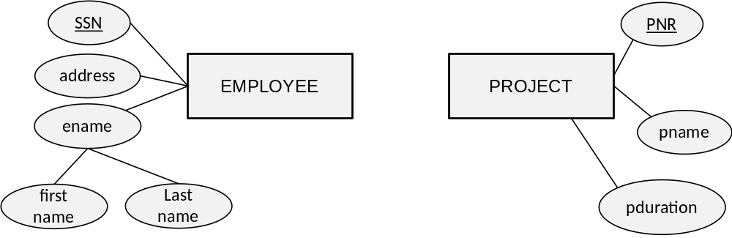
Mapping Entity Types
EMPLOYEE(SSN, address, first name, last name)
PROJECT(PNR, pname, pduration)

Slide 5
Mapping Relationship Types
Mapping a binary 1:1 relationship type
Mapping a binary 1:N relationship type
Mapping a binary M:N relationship type
Mapping unary relationship types
Mapping n-ary relationship types

Slide 6
Mapping a Binary 1:1 Relationship Type
Create two relations: one for each entity type participating in the relationship type
The connection can be made by including a foreign key in one of the relations to the primary key of the other
In case of existence dependency, put the foreign key in the existent dependent relation and declare it as NOT NULL
The attribute types of the 1:1 relationship type can then be added to the relation with the foreign key

Slide 7
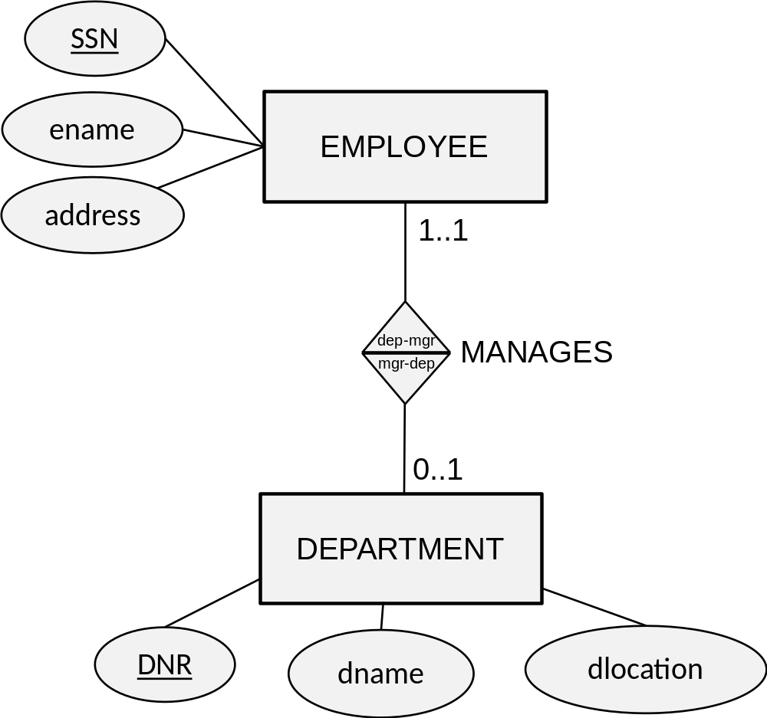
Mapping a Binary 1:1 Relationship Type

Slide 8
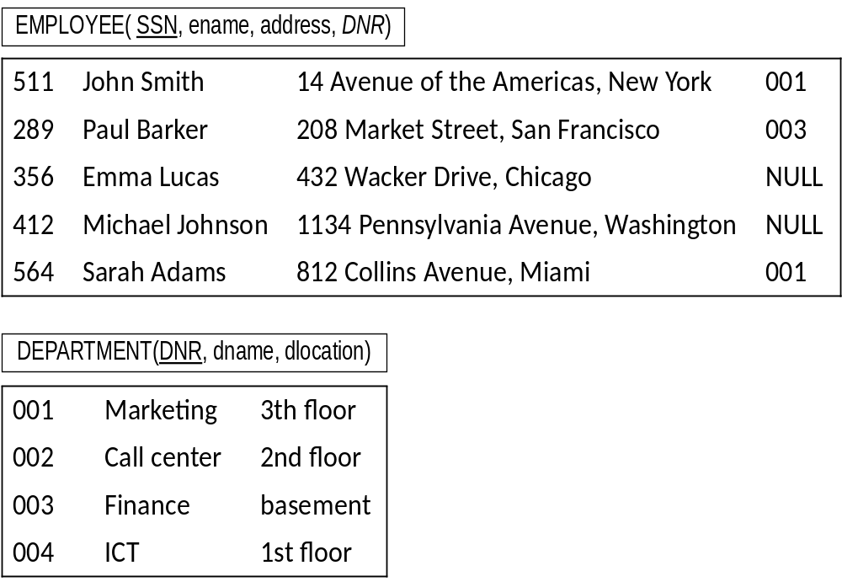
Mapping a Binary 1:1 Relationship Type
EMPLOYEE(SSN, ename, address, DNR)
DEPARTMENT(DNR, dname, dlocation)

Slide 9
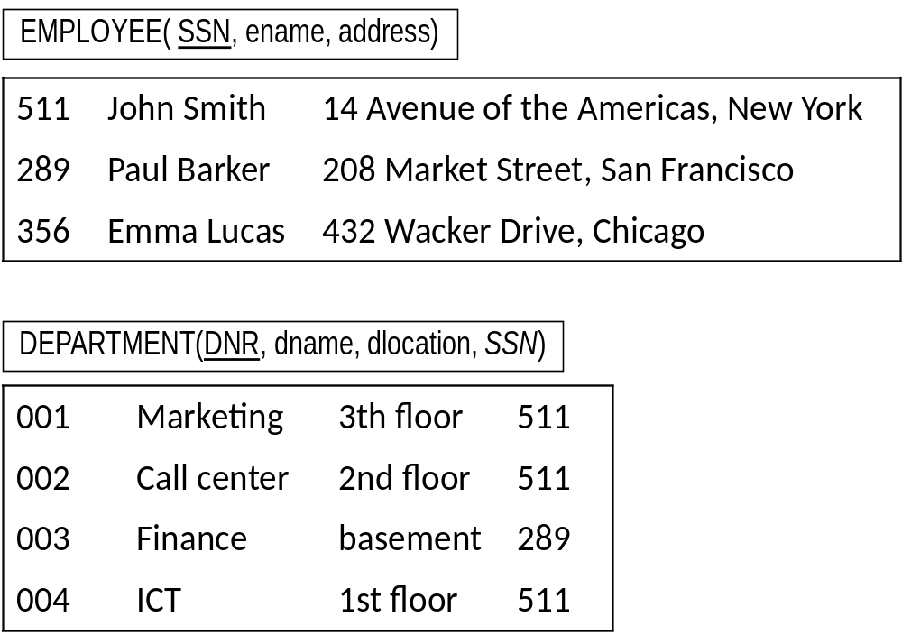
Mapping a Binary 1:1 Relationship Type
EMPLOYEE(SSN, ename, address)
DEPARTMENT(DNR, dname, dlocation, SSN)

Slide 10
Mapping a Binary 1:N Relationship Type
Binary 1:N relationship types can be mapped by including a foreign key in the relation corresponding to the participating entity type at the N-side of the relationship type
The foreign key refers to the primary key of the relation corresponding to the entity type at the 1-side of the relationship type
Depending upon the minimum cardinality, the foreign key can be declared as NOT NULL or NULL ALLOWED
The attribute types of the 1:N relationship type can be added to the relation corresponding to the participating entity type

Slide 11
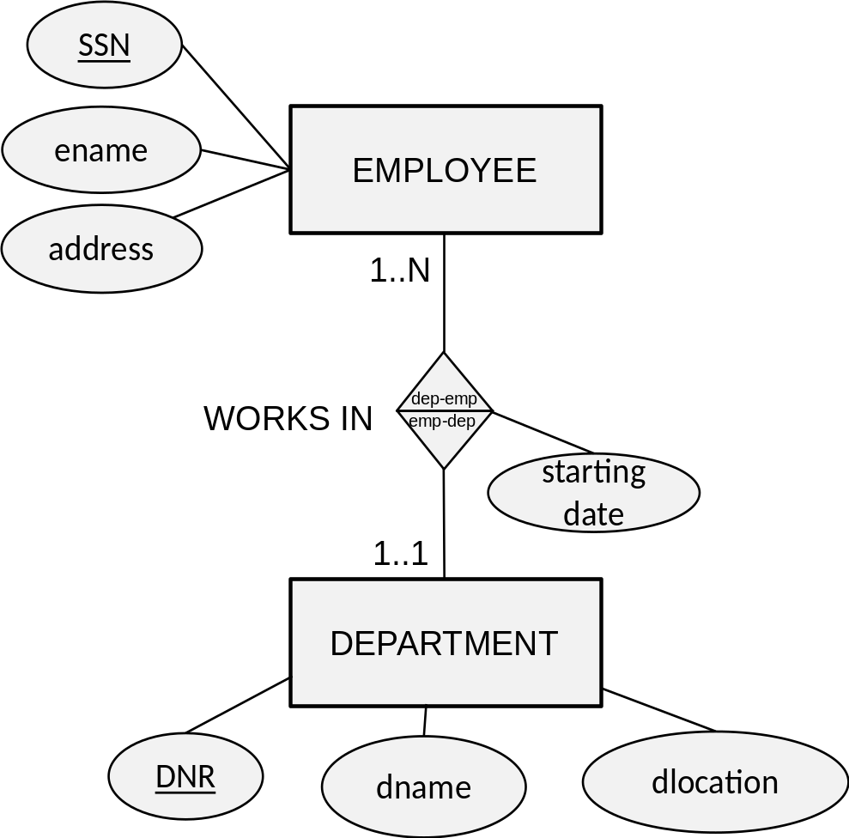
Mapping a Binary 1:N Relationship Type
EMPLOYEE(SSN, ename, address, starting date, DNR)
DEPARTMENT(DNR, dname, dlocation)

Slide 12
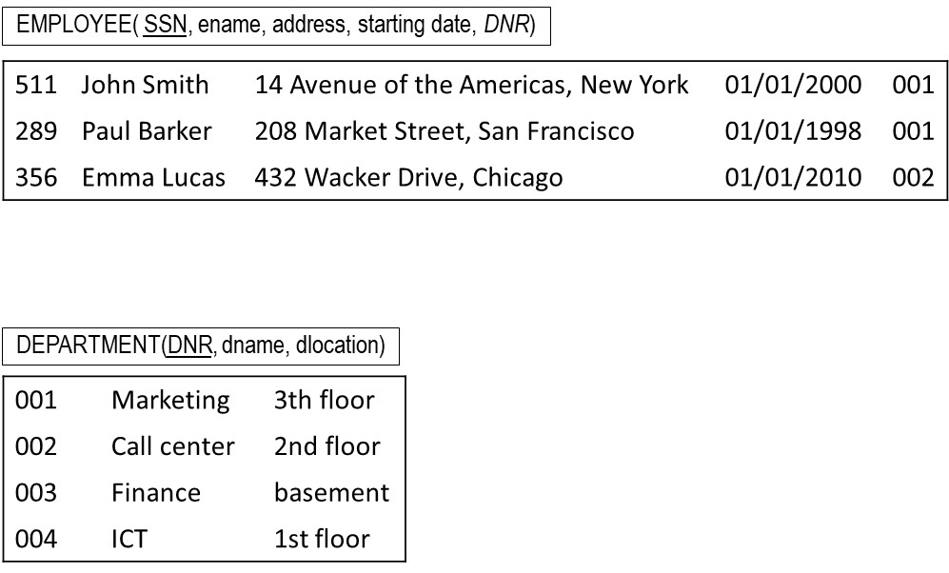
Mapping a Binary 1:N Relationship Type

Slide 13
Mapping a Binary N:M Relationship Type
M:N relationship types are mapped by introducing a new relation R
The primary key of R is a combination of foreign keys referring to the primary keys of the relations corresponding to the participating entity types
The attribute types of the M:N relationship type can also be added to R

Slide 14
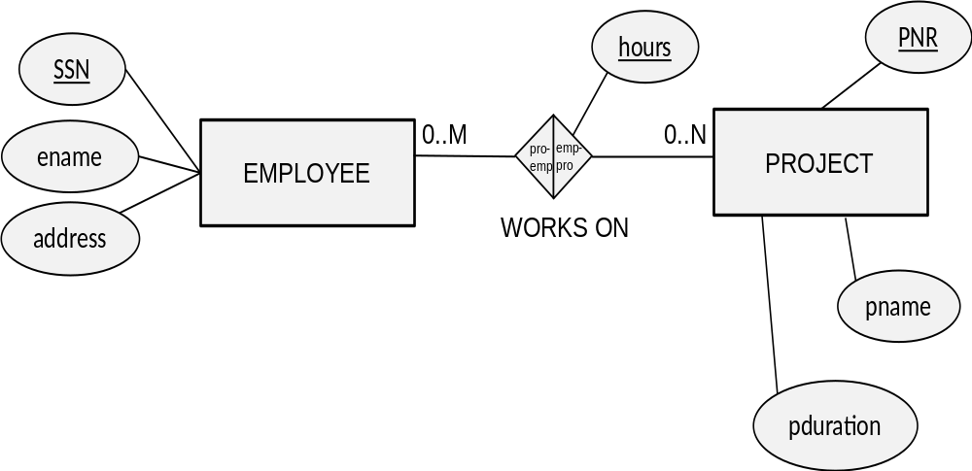
Mapping a Binary M:N Relationship Type
EMPLOYEE(SSN, ename, address)
PROJECT(PNR, pname, pduration)
WORKS_ON(SSN, PNR, hours)

Slide 15
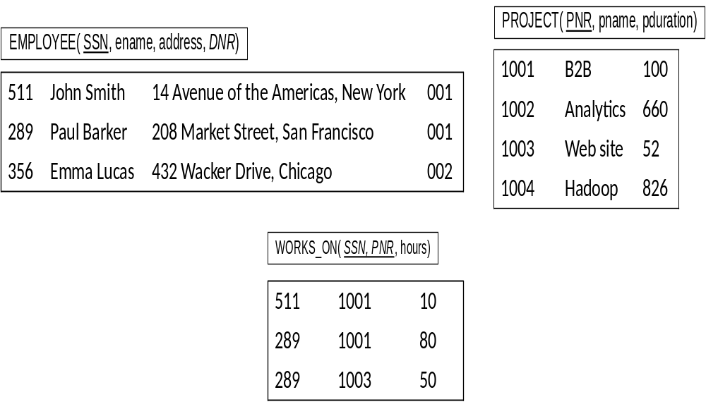
Mapping a Binary M:N Relationship Type

Slide 16
Mapping Unary Relationship Types
A recursive 1:1 or 1:N relationship type can be implemented by adding a foreign key referring to the primary key of the same relation
For a N:M recursive relationship type, a new relation R needs to be created with two NOT NULL foreign keys referring to the original relation

Slide 17
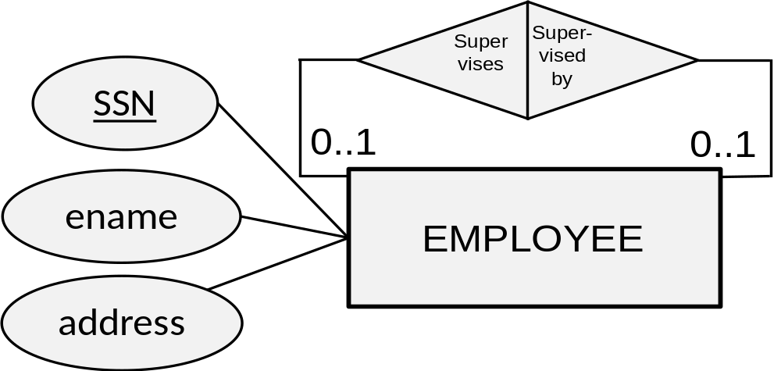
Mapping Unary Relationship Types
EMPLOYEE(SSN, ename, address, supervisor)

Slide 18
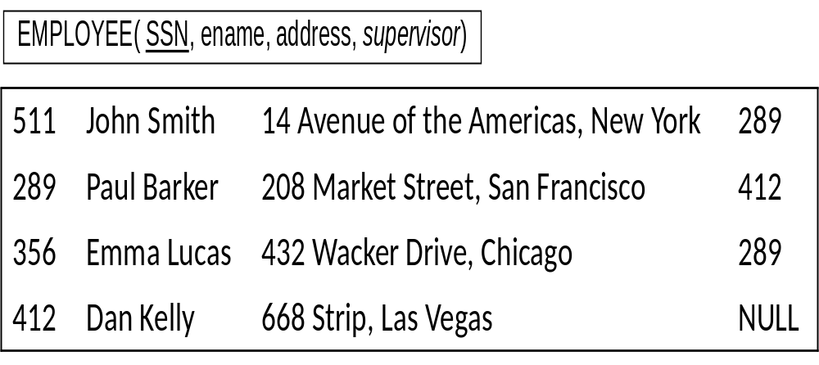
Mapping Unary Relationship Types

Slide 19

Mapping Unary Relationship Types
EMPLOYEE(SSN, ename, address)
SUPERVISION(Supervisor, Supervisee)

Slide 20
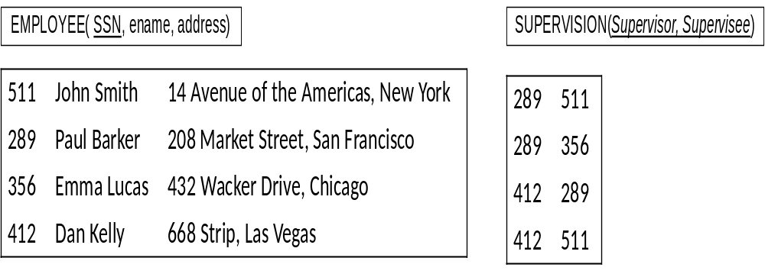
Mapping Unary Relationship Types

Slide 21
Mapping n-ary Relationship Types
To map an n-ary relationship type, we first create relations for each participating entity type
We then also define one additional relation R to represent the n-ary relationship type and add foreign keys referring to the primary keys of each of the relations corresponding to the participating entity types
The primary key of R is the combination of all foreign keys which are all NOT NULL
Any attribute type of the n-ary relationship can also be added to R

Slide 22
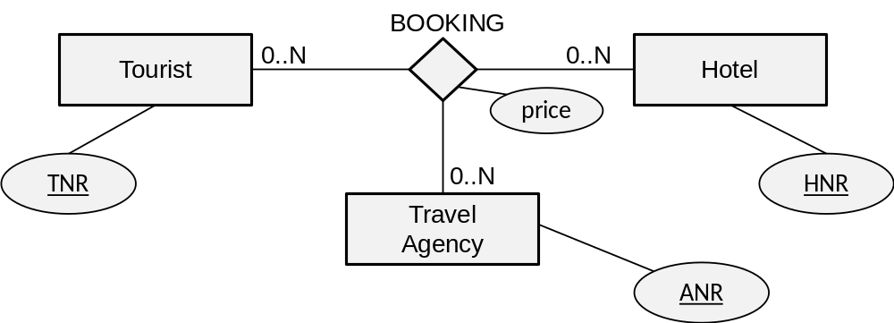
Mapping n-ary Relationship Types
TOURIST(TNR, …)
TRAV_AGENCY(ANR, …)
HOTEL(HNR, …)
BOOKING(TNR, ANR, HNR, price)

Slide 23
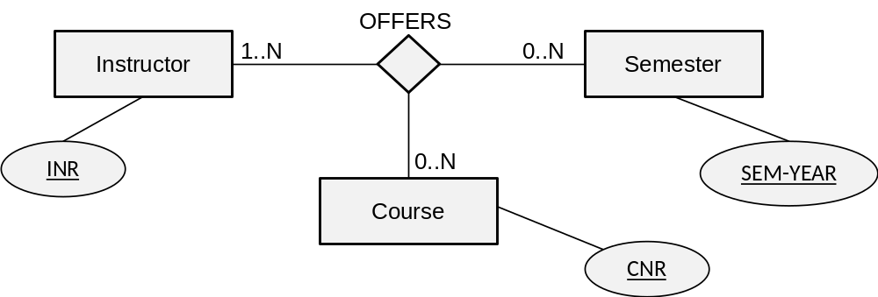
Mapping n-ary Relationship Types
INSTRUCTOR(INR, …)
COURSE(CNR, …)
SEMESTER(SEM-YEAR, …)
OFFERS(INR,CNR,SEM-YEAR)

Slide 24
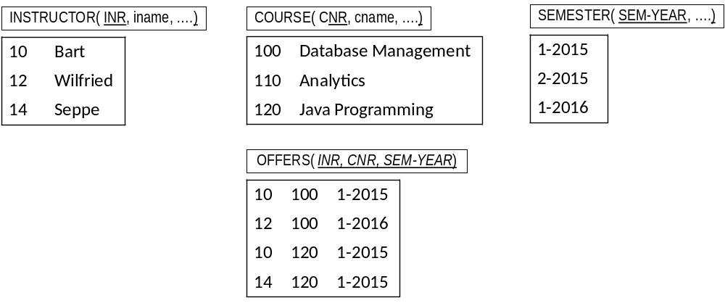
Mapping n-ary Relationship Types

Slide 25
Mapping Multivalued Attribute Types
For each multivalued attribute type, we create a new relation R
We put the multivalued attribute type in R together with a foreign key referring to the primary key of the original relation
Multivalued composite attribute types are again decomposed into their components
The primary key can then be set based upon the assumptions

Slide 26
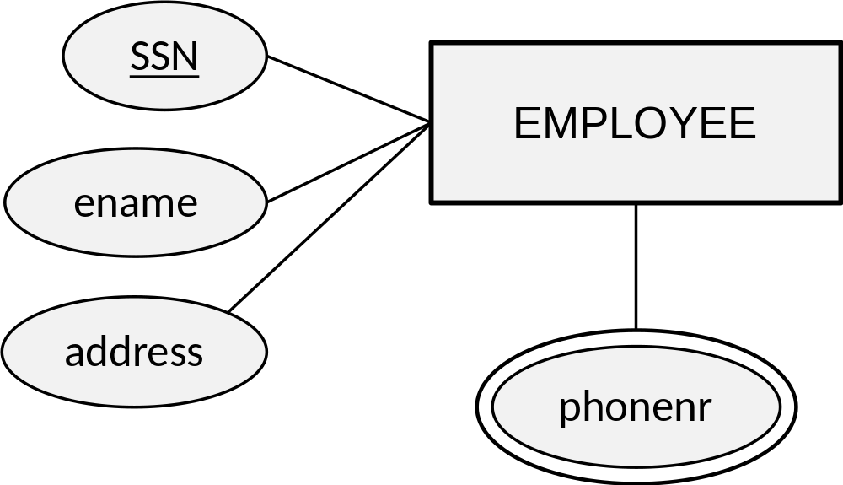
Mapping Multivalued Attribute Types
EMPLOYEE(SSN, ename, address)
EMP-PHONE(PhoneNr, SSN)

Slide 27
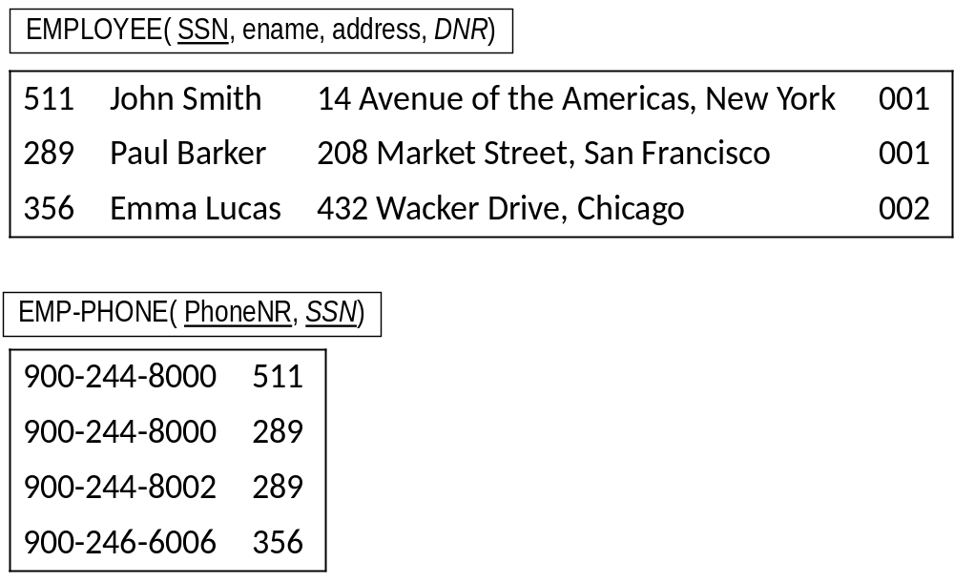
Mapping Multivalued Attribute Types

Slide 28
Mapping Weak Entity Types
A weak entity type should be mapped into a relation R with all its corresponding attribute types
A foreign key must be added referring to the primary key of the relation corresponding to the owner entity type
Because of the existence dependency, the foreign key is declared as NOT NULL
The primary key of R is then the combination of the partial key and the foreign key

Slide 29
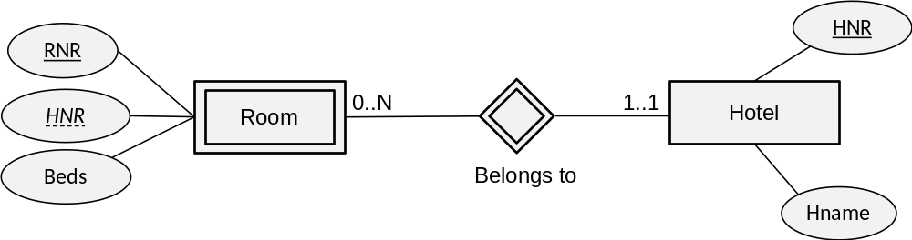
Mapping Weak Entity Types
Hotel (HNR, Hname)
Room (RNR, HNR, beds)

Slide 30
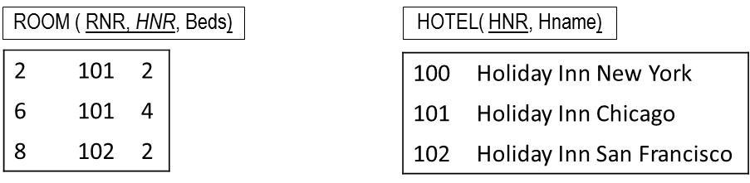
Mapping Weak Entity Types

Slide 31
Putting it All Together
ER Model | Relational model
Entity type | Relation
Weak entity type | Foreign key
1:1 or 1:N relationship type | Foreign key
M:N relationship type | New relation with two foreign keys
N-ary relationship type | New relation with N foreign keys
Simple attribute type | Attribute type
Composite attribute type | Component attribute type
Multivalued attribute type | Relation and foreign key
Key attribute type | Primary or alternative key

Slide 32
Putting it All Together
EMPLOYEE(SSN, ename, streetaddress, city, sex, dateofbirth, MNR, DNR)
  MNR foreign key refers to SSN in EMPLOYEE, NULL ALLOWED
  DNR foreign key refers to DNR in DEPARTMENT, NOT NULL
DEPARTMENT (DNR, dname, dlocation, MGNR)
  MGNR: foreign key refers to SSN in EMPLOYEE, NOT NULL
PROJECT (PNR, pname, pduration, DNR)
  DNR: foreign key refers to DNR in DEPARTMENT, NOT NULL
WORKS-ON (SSN, PNR, HOURS)
  SSN foreign key refers to SSN in EMPLOYEE, NOT NULL
  PNR foreign key refers to PNR in PROJECT, NOT NULL

Slide 33
Mapping a Conceptual EER Model to a Relational Model
Mapping an EER specialization
Mapping an EER categorization
Mapping an EER aggregation

Slide 34
Mapping an EER Specialization
3 options:
  Create a relation for the superclass and each subclass and link them with foreign keys
  Create a relation for each subclass and none for the superclass
  Create one relation with all attribute types of the superclass and subclasses and add a special attribute type

Slide 35
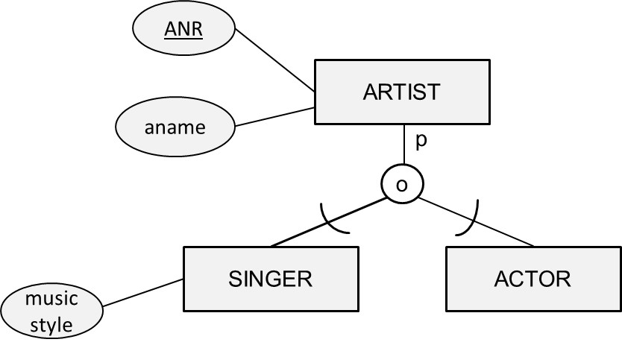
Mapping an EER Specialization
ARTIST(ANR, aname, …)
SINGER(ANR, music style, …)
ACTOR(ANR, …)

Slide 36
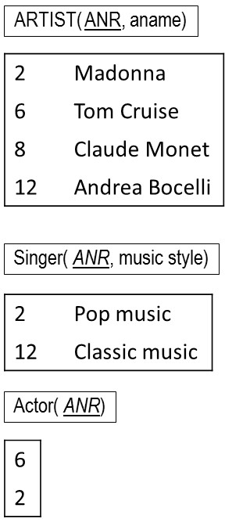
Mapping an EER Specialization

Slide 37
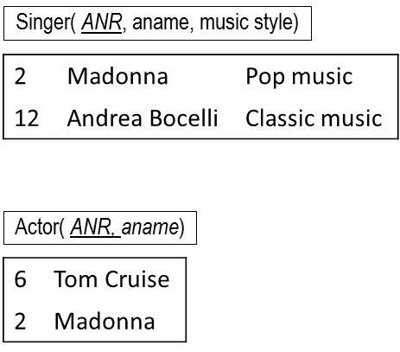
Mapping an EER Specialization
SINGER(ANR, aname, music style, …)
ACTOR(ANR, aname, …)

Slide 38
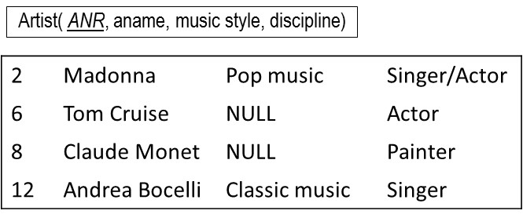
Mapping an EER Specialization
ARTIST(ANR, aname, music style, …, discipline)

Slide 39
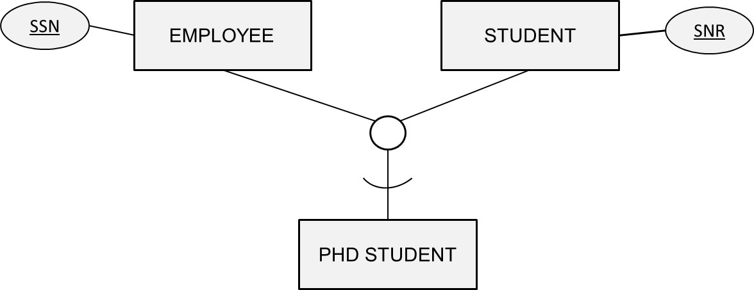
Mapping an EER Specialization
EMPLOYEE(SSN, …)
STUDENT(SNR, …)
PHD-STUDENT(SSN, SNR, …)

Slide 40
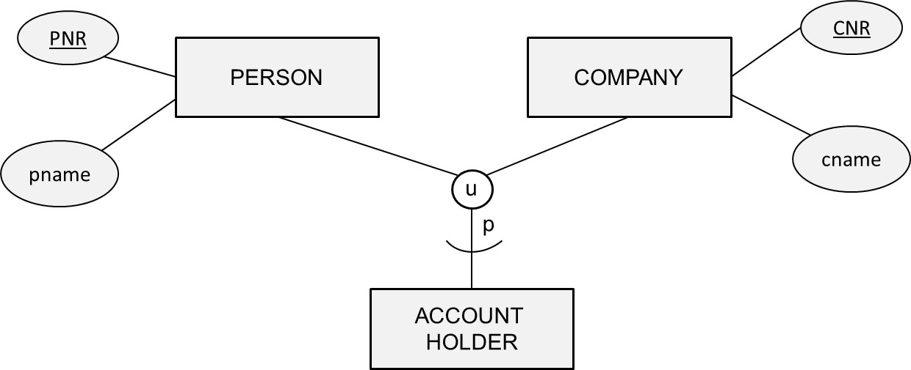
Mapping an EER Categorization
PERSON(PNR, …, CustNo)
COMPANY(CNR, …, CustNo)
ACCOUNT-HOLDER(CustNo, …)

Slide 41
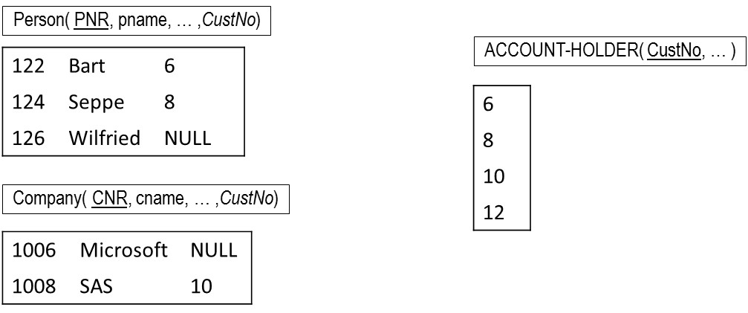
Mapping an EER Categorization

Slide 42
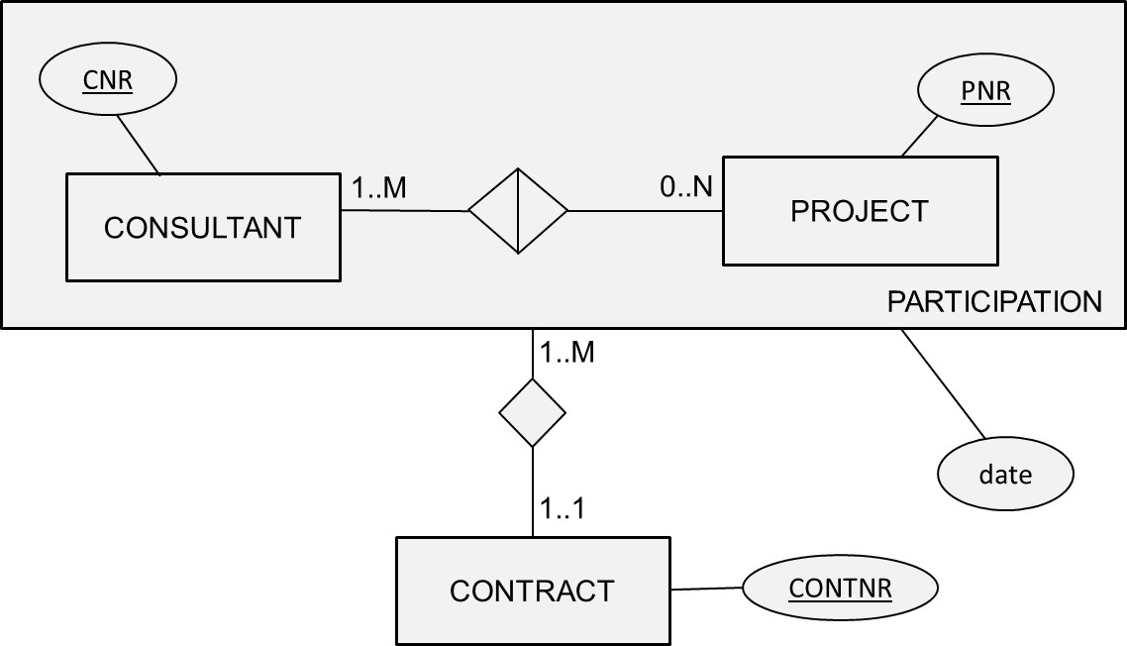
Mapping an EER Aggregation
CONSULTANT(CNR, …)
PROJECT(PNR, …)
PARTICIPATION(CNR, PNR, CONTNR, date)
CONTRACT(CONTNR, …)

Slide 43
Conclusions
Relational Model
Normalization
Mapping a conceptual ER model to a relational model
Mapping a conceptual EER model to a relational model

Slide 44
More information?
www.pdbmbook.com

